Slide 1
TASK 3
BIRUNGI JEANRITAH ROENAH

Slide 2
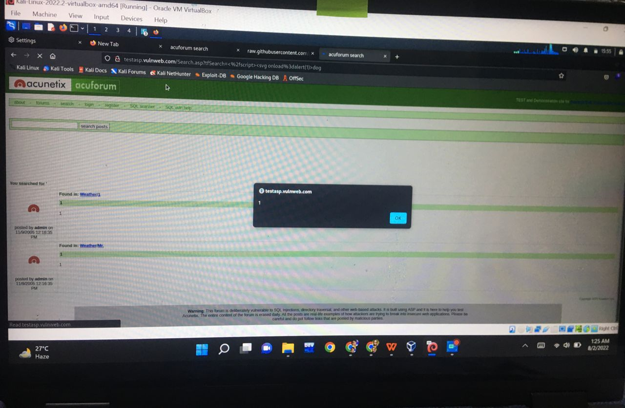

Slide 3
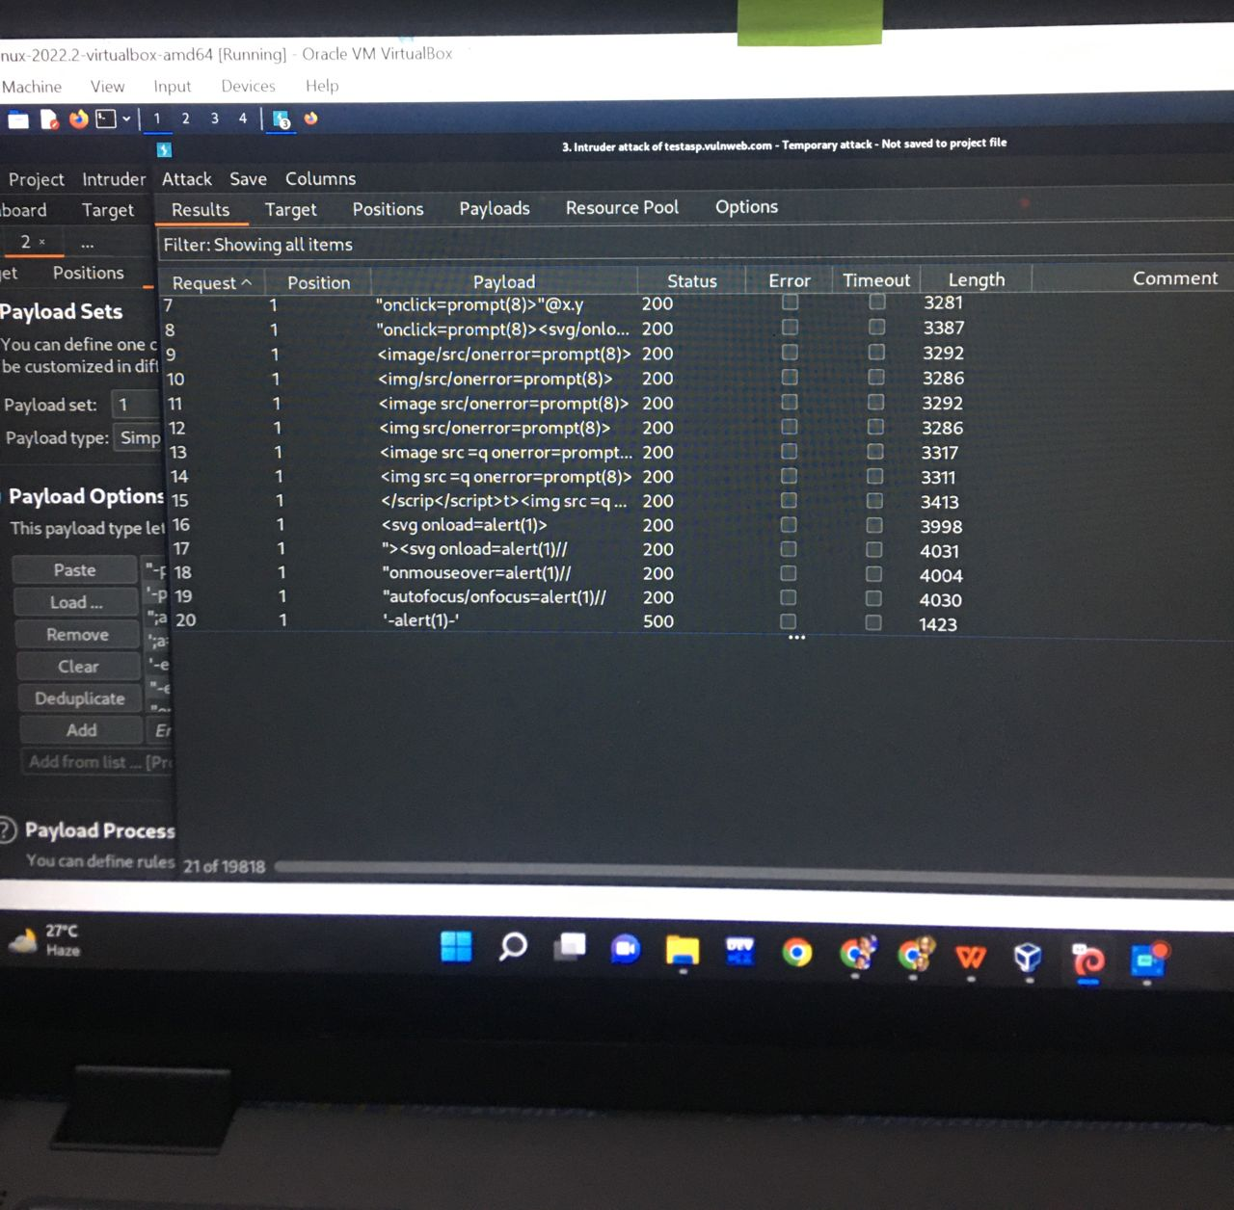

Slide 4
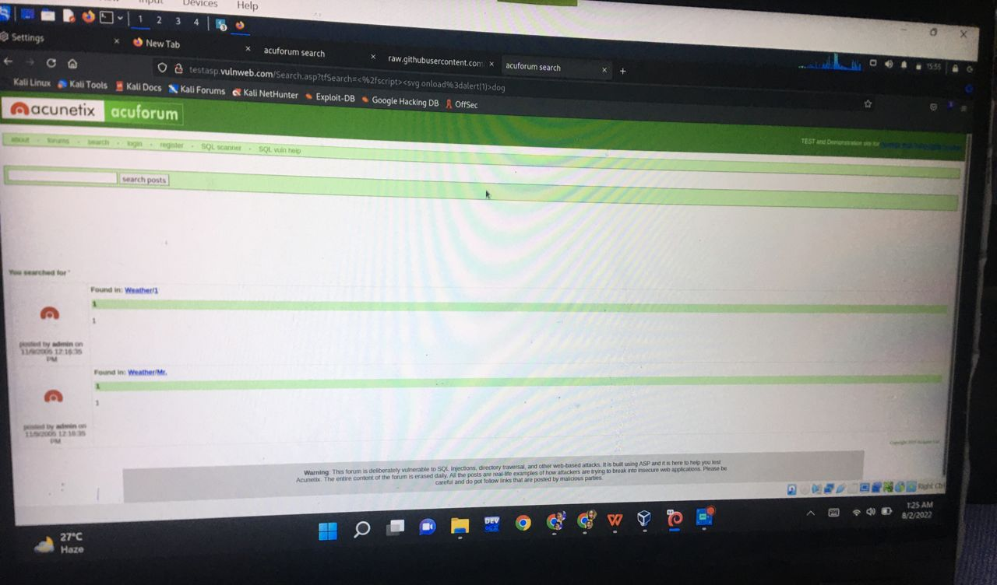

Slide 5
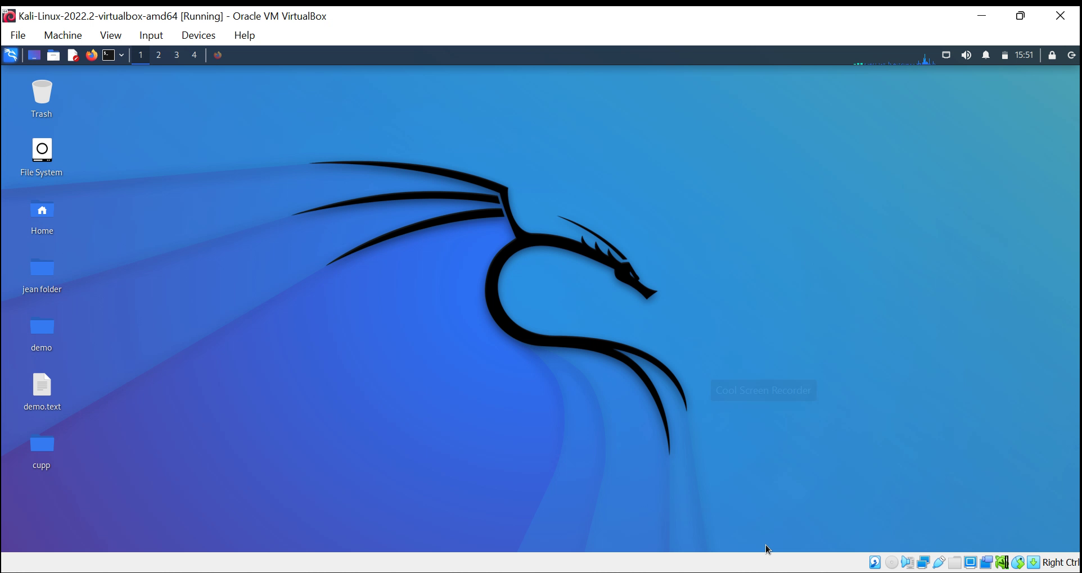

Slide 6
THE SCREEN RECORDING IS ON THE ABOVE SLIDE!!..

Slide 7
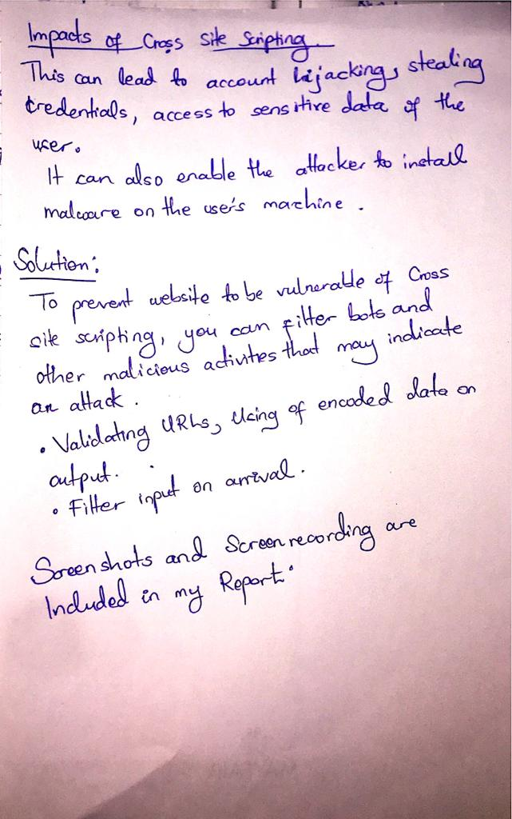
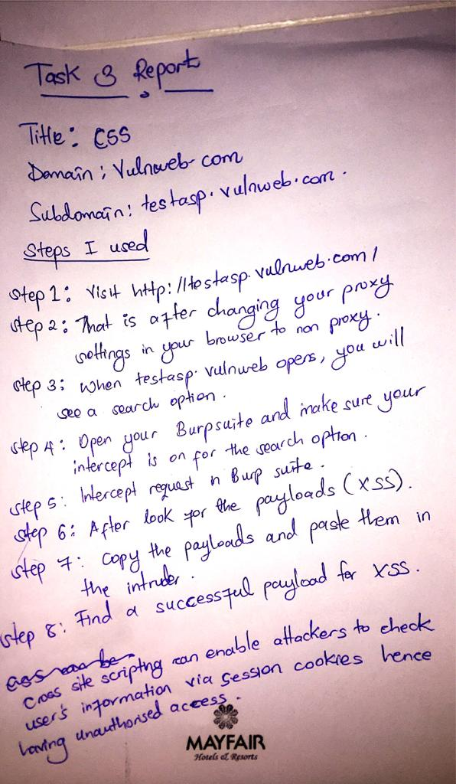

Slide 8
